Slide 1
Word Study Unit 9: Geography
What is geography?
Geography is the
study of the
Earth- its surface, its climate, its plant life, and its animal life.

Slide 2
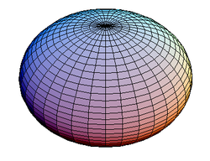
Our planet is an oblate spheroid.
Earth is NOT a perfect sphere because it is slightly flattened along the North and South Poles, which is necessary in order for the Earth to rotate.

Slide 3
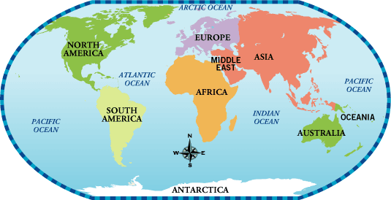
A Map of Our World

Slide 4
Continents
There are 7 continents in our world.
Continents are vast bodies of land.
We live on the continent:
North America
The other 6 continents are:
South America
Europe
Asia
Africa
Antarctica
Australia/Oceania
Attention Please: The continent of Australia is now being paired with Oceania in order to incorporate New Zealand and other islands in the Pacific Ocean that want to be recognized as their own land as opposed to just being called Australia. Therefore, Oceania incorporates Australia, New Zealand, and the other islands in the Pacific Ocean.

Slide 5
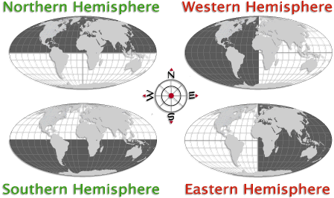
Hemisphere: Half a sphere

Slide 6
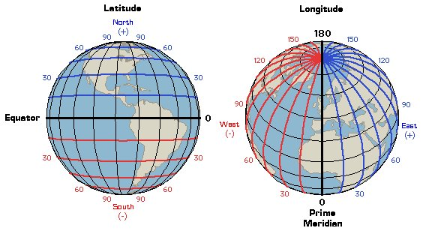
Latitude and Longitude Lines

Slide 7
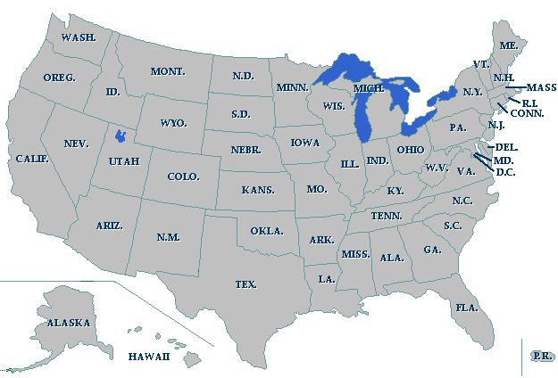
Which region of the United States of America do you think New York is located in?
New York is located in the northeastern region of the United States of America.

Slide 8
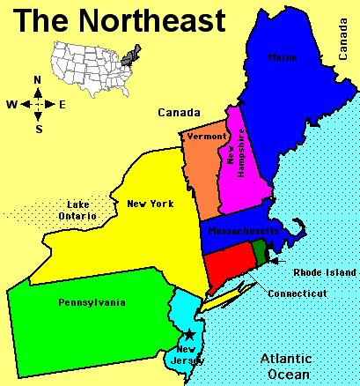
Which states border New York? Lines that separate each state are known as boundary lines.

Slide 9
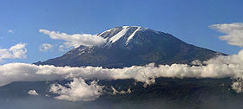
Mt. Kilimanjaro
-Tallest mountain in Africa
-Elevation of 19,341 feet

Slide 10
Landforms: Any natural formation of rock and dirt
Landforms can be as large as a mountain and as small as a hill.

Slide 11
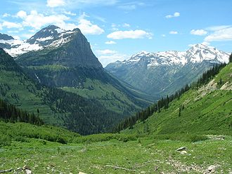
Valley: land with a depression or sunken in surface
U-shaped valley in Glacier National Park in Montana, United States.

Slide 12
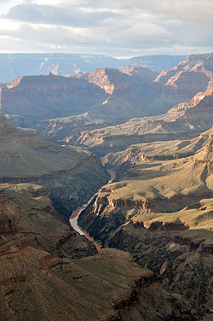
Canyon: a deep valley with steep sides (Grand Canyon in Arizona)

Slide 13
Click and Drag Continent Identification Activity
http://www.softschools.com/social_studies/continents/map.jsp
I

